Slide 1
Theory and Practice of Curriculum Development EDU705
CMU
2014
Notes:
Curriculum arises / shaped by the world in which it exists.
Think about changes you have notices over your learning experiences, your parents and grandparents and their accounts.

Slide 2
Cooperative Learning is:
A structured form of small group problem solving that incorporates
the use of heterogeneous teams,
maintains individual accountability,
promotes positive interdependence,
instills group processing, and
sharpens social skills
Notes:
Johnson and Johnson – cooperative learning – cite references. How do you see this definition as different from other group work you’ve been involved in??
http://www.co-operation.org/pages/cl.html
Other sources/reasons for cooperative learning – learning happens to various depths – self and textbook, self and teacher, self and fellow learners.

Slide 3
Theories Impacting Design
Philosophical foundations – belief systems
Psychological foundations – how we think
Sociological/economic foundations – norms of society

Slide 4
Philosophical, Psychological, Sociological?

Slide 5
Philosophical, Psychological, Sociological?

Slide 6
Curriculum Development
Art or Science
Definition
In your groups develop a definition of “Curriculum”
10 minutes post on wall (flip chart paper)
Notes:
Political, economic and social factors has impacted higher education in the past decades.
Political
Economic
Social – concept of post secondary education as preparation for employment
Increasing #s of students with differing backgrounds and expectations
Institutions expected to offer a broader range of courses with more flexible delivery
reduced public funding for higher education
Role and effect of technology
Core content vs optional (security and attention given to core courses - who decides what else (optional)??
Allocation of time within a curriculum an indicator of where values lie – I.e. amount of time given to different topics, but also time available for acquiring different kinds of skill and knowledge.

Slide 7
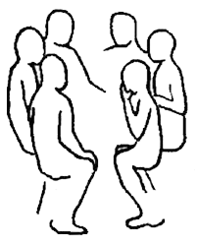
Cooperative Learning
In your groups discuss and prepare to present on flip chart at least one of each of the following foundations for curriculum development and how these impact on curriculum planning:
Psychological
Sociological
Philosophical foundations
Notes:
psychological foundation – how the brain works
sociological – norms of society
philosophical foundations – belief systems

Slide 8
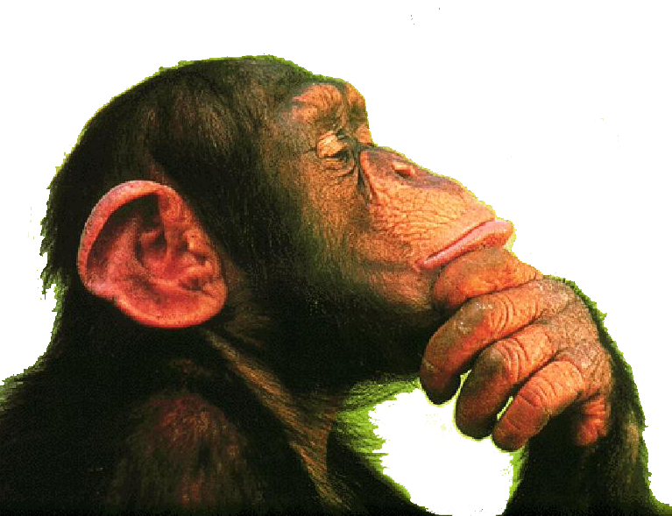
Your Learning Mission
What are your life/learning influences that you bring to your study of curriculum?
Notes:
Have them discuss some of the things from their lives.

Slide 9
Definition of Curriculum
The program of intended learning devised by the planner
Series of structured learning experiences
Subject content and skills that make up an educational program
Emphasis depends on philosophical, psychological and social forces
Notes:
What does assessment tell us about what is valued? Undergrad education is often evaluated through multiple-choice tests which can be machine marked. Tests held several times per semester and provide regular feedback to students on their progress. Test will stand up to challenged and different markers will rarely disagree over results.
Considered In Europe, by comparison it is common for even undergrad education to be assessed by an extensive oral examinations with ranges of the content of many units and is conducted by a panel of assessors. Students are expect to show how they can integrate what they have learned and assessors can delve into any aspect in depth. An oral examination is not particularly reliable – different examiners might agree or disagree about interpretations. Students often schedule their own examination when they feel ready.

Slide 10
Definition
Curriculum design is the process of formulating a specific educational platform that defines the beliefs of what should be in the curriculum (Henderson & Hawthorne, 1995)

Slide 11
A Definition of Curriculum
(Daniel Tanner, 1980)
“The planned and guided learning experiences and intended learning outcomes, formulated through the systematic reconstruction of knowledge and experiences, under the auspices of the school, for the learners’ continuous and willful growth in personal social competence.”

Slide 12
Fundamental Questions in Developing Curriculum
What educational purposes should the school seek to attain?

Slide 13
Fundamental Questions in Developing Curriculum
What educational experiences can be provided that are likely to attain these purposes?

Slide 14
Fundamental Questions in Developing Curriculum
How can these educational experiences be effectively organized?

Slide 15
Fundamental Questions in Developing Curriculum
How can we determine whether and to what extent these purposes are being attained?

Slide 16
Your Curriculum Plan
Identify your area of interest/topic/subject or level

Slide 17
Guiding Questions
What content and processes are included in EDU705?
How does your learning journey affect your approach to curriculum?
Why is it important to define “curriculum”?

Slide 18
Guiding Questions
How has the purpose of education changed over the years?
What influences curriculum decisions?
How have our societal values and government policies impacted curriculum?

Slide 19
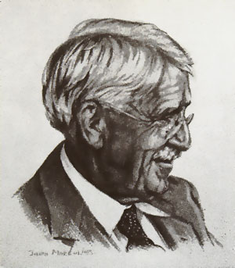
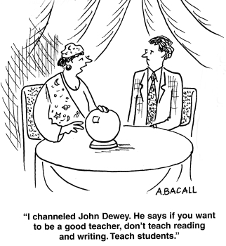
Influential Individuals
John Dewey ~ 1916
Curriculum generated out of social situation and founded on capacities of the learner and demands of the environment.
Based on the learner's experiences rather than the traditional organized disciplines.
Notes:
Philosophical approaches influencing curriculum development
All curriculum must be generated out of social situation and be founded on the capacities of the learner and the demands of the environment.
Based on the experiences of the learner rather than the traditional organized disciplines.
Radical idea in 1916

Slide 20
John Dewey and Experiential Education
Role of education - to encourage, promote and guide an active learning process.
Person-centred learning.
Notes:
Dewey’s groundbreaking educational philosophy
Dewey, J. The Child and the Curriculum. Chicago: University of Chicago Press, 1902.
Dewey's naturalistic and interactional theory of culturally mediated human experience - Dewey emphasizes the concept of participation.
In Chicago in early 1900s
. Dewey uses growth instead of the more usual concept of 'development'. Dewey rejects any idea of passivity or receptivity on the part of the child: the child is a participant, not a spectator. The child is already active and need not be made so by the educator. In a general sense, education has only one goal: to make more education possible.

Slide 21
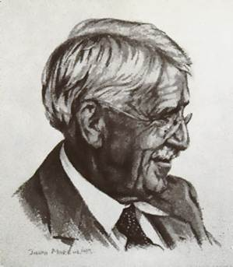
Dewey
Based on:
Continuity: humans are sensitive to experience, every experience influences future experiences.
Interaction: past experiences interact with the present situation to create one’s present experience
Notes:
Similarity to Malcolm Knowles work in adult learning situations.

Slide 22
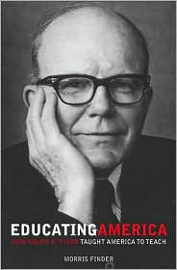
Ralph Tyler
1902–1994
Curriculum must address four essentials:
What is the purpose or aims of education?
What are the learning experiences designed to achieve these aims?
How can these learning experiences be organized?
How will we know these aims have been achieved?
Notes:
A very different approach is taken by educators who see curriculum development not as one of values or philosophy, but as technical, a question of what means to use to achieve certain desirable ends and how to measure results so that improvements can be soundly based.
Using a systems approach, curriculum developers bring the methods of applied science to education. The systems approach developed out of the work of Ralph Tyler , who stressed that education should be a purposeful activity, that schools need to define their goals, teach toward them and evaluate students’ progress to see whether they are being achieved (Tyler, 1949)
Tyler’s approach was refined and elaborated into what has come to be called the “instructional system's” approach to course design. Romiszowski (1984), one of the chief proponents described it as a three phase planning process of establishing precise objectives, planning study methods and testing them.
Classical Behaviour Modification Training Model:
Need Assessment
Learning Outcomes
Program Design
Program Delivery
Evaluation of Teaching and Learning
Proponents of the systems approach often underestimate the impact of value and through this process may convey the curriculum is “value free” while in practice it may convey that values are not important. I.e. ethical issues, client practitioner relations.

Slide 23
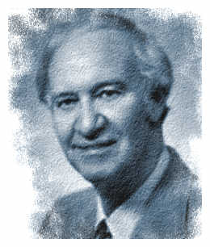
Malcolm Knowles
Reorienting adult educators from 'educating people' to 'helping them learn‘
Recognized impact of life experience
Pedagogy vs. andragogy

Slide 24
Andragogy
Andragogy consists of learning strategies focused on adults. It is often interpreted as the process of engaging adult learners with the structure of learning experience.
Originally used by Alexander Kapp (a German educator) in 1833, andragogy was developed into a theory of adult education by the American educator Malcolm Knowles.
Knowles asserted that andragogy (Greek: "man-leading") should be distinguished from the more commonly used pedagogy (Greek: "child-leading").
Knowles' theory can be stated with six assumptions related to motivation of adult learning.

Slide 25
Andragogy
Adults need to know the reason for learning something (Need to Know)
Experience (including error) provides the basis for learning activities (Foundation).
Adults need to be responsible for their decisions on education; involvement in the planning and evaluation of their instruction (Self-concept).
Adults are most interested in learning subjects having immediate relevance to their work and/or personal lives (Readiness).
Adult learning is problem-centered rather than content-oriented (Orientation).
Adults respond better to internal versus external motivators (Motivation).
The term has been used by some to allow discussion of contrast between self-directed and 'taught' education.

Slide 26
Other impacts
Kaufman and English (needs assessment) 1979
Wittich and Schuller (technology) 1979
Popham and Baker (instructional activities) 1970
Keller (1978) on motivation
Kemp (1985)
Notes:
Kaufman and English (1979) and Dewey (1939) emphasized the importance of determining learner needs prior to developing curriculum for that learner.
Wittich, Walter A. and Schuller, Charles F. (1979).Instructional Technology: Its Nature and Use. New York: Harper and Row. (another book: audiovisual tools – their nature and use)
Popham and Baker (1970) found that without specific training, very few teachers establish behavioral objectives that are tied closely to either instructional activity or evaluation methods.
Popham, J. W. & Baker, E. L. (1970). Systematic Instruction. Englewood Cliffs, NJ: Prentice Hall.

Slide 27
Standardization
Vision 2000 – focused at college level education in Ontario
Balancing college curriculum – general education, generic skills and specific vocational skills
set of intentions in the classroom
product or set of outcomes
process or set of experiences

Slide 28
Philosophies and their impact on Curriculum

Slide 29
Traditional approach
Following the structure of knowledge in a discipline
Programs divided into units and topics around important concepts
Structure exists within the subject matter, rather than learner needs or interests
Notes:
CURRICULUM ORIENTATION – SUBJECT CENTRED according to discipline
Logical organization – based on chronology, causal, scale of operation, form of expression
existing within the subject matter itself and the way the discipline is usually structured, rather than learner interests, the way people learn, or the way in which problems present themselves in real situations.
Knowledge is a body of theory which has developed, refined and tested over time. Emphasis is on technical, rational and managerial aspects of knowledge rather than on personal or expressive knowledge. Strong leaning towards theoretical knowledge
Content is often chosen for breadth . Coverage is considered important. Deep investigation is often sacrificed. Content is logically structured and presented – like I’m doing here.

Slide 30
Cognitive Approach
Curriculum focused on cognitive development
View that the major function is to develop the mind, help students learn how to learn and provide them with opportunities to strengthen their intellectual faculties
Acquiring conceptual structures and thinking processes in a particular discipline
Knowledge is personally constructed
Notes:
CURRICULUM ORIENTATION – LEARNER CENTRED according to discipline: personal fulfillment, develop indivdiual talents, self-realization, creative expression, personal talents and interests
These philosophical approaches – outlined so far – experiential (Dewey), systems based (Tyler), or cognitive (Miller/Seller) represents a different position on curriculum develop. Each has implications about how education and learning will be carried out. While you may value educational goals found in several approaches,

Slide 31
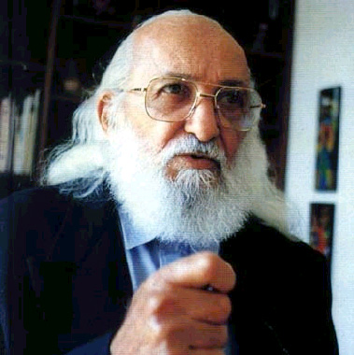
Socially Critical Approach
Freire ~ 1970
Role of curriculum - to examine society, its institution and its cultural products exposing the covert values that guide the way these work.
Seeking to develop a social conscience
This approach influential in humanities and social sciences
Notes:
CURRICULUM ORIENTATION – SOCIETY CENTRED to develop and serve the needs of society rather than the individual.
The most famous socially critical curricula are the literacy programs developed by the South American educator Paolo Freire. Working with illiterate peasants in Brazil. Freire devised a curriculum that not only met their literacy needs by helped students develop a vocabulary that enable them to question their working conditions and the political system which supported their exploitation. The program simultaneously an adult literacy program and a political education program.

Slide 32
Curriculum Design
Curriculum design is the process of formulating a specific educational platform that defines the beliefs of what should be in the curriculum (Henderson & Hawthorne, 1995)

Slide 33
Continuum
Traditional – discipline based
Systems Based
Cognitive
Experiential
Socially Critical
Tyler Dewey Frere

Slide 34
Which Approach?
Each approach represents a different position on:
the purpose of higher education
the way education should be carried out
Example: Problem based curricula places a high value on experiential learning along with a cognitive emphasis on the development of intellectual abilities.
Notes:
Governments favour a competency approach because of its promise of increased accountability and have attempted to influence post secondary institution to adopt it whenever possible. Professional bodies have also endorsed a competency-based approach while some are learning toward or re-design into a systems approach.
Can you see from curriculum you have taught or developed a particular approach?
Consider your learning experiences, evidence of the different approaches?

